Slide 1

Airbnb Host Dataset in Boston
Using Linear Regression
Group 8

Slide 2
About the Company
Airbnb, Inc. is an online marketplace for arranging or offering lodging, primarily homestays, or tourism experiences.
The company provides a platform for hosts to accommodate guests with short-term lodging and tourism-related activities.

Slide 3
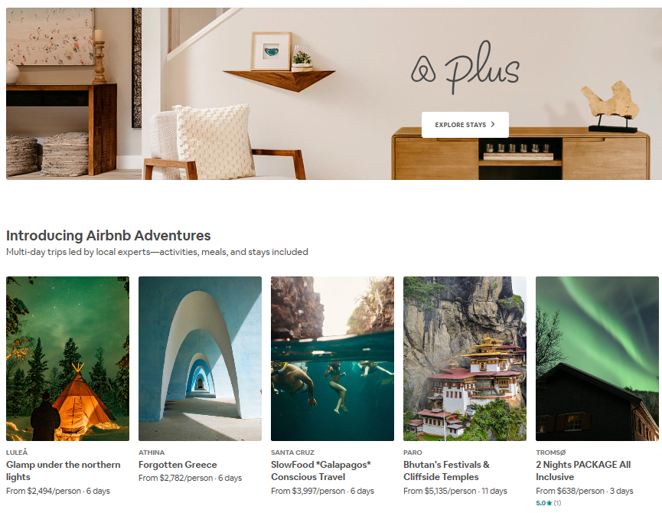
Goals and Objectives
Provide hosts a better prediction model to make a fair price to get the most RevPAR (Revenue Per Available Room)
Provide the company a visualized model of the potential profit of one new house (or room)
Help the company to identify the most valuable hosts

Slide 4

Industry and Company
Hotel & Lodging Industry
Airbnb
Notes:
Both the industry and Airbnb claimed they were serving different markets and had different underlying business models. As Airbnb become more successful and grown to being larger than the companies in the hotel industry, the hotel industry began to realize they had something to worry about.
In a recent study, Smith Travel Research (STR) showed that Airbnb's market share ranges between 1.8% and 8.9% in top hotel markets in the world (Haywood, Mayock, Freitag, Owoo, & Fiorilla, 2017)

Slide 5
Data Description
Data source : http://insideairbnb.com/get-the-data.html
Datasets: listings.csv(building models), reviews.csv, calendar.csv.
Time covered: 2008-2019
Region: Boston
# of observations : 5711
# of variables : 39
Index
id | listing id
host_id | host id
Independent Variables
host_since | the date of becoming a host
host_response_time | Time taken by host to respond
host_response_rate | the rate at which the host will respond
host_is_superhost | whether he or she is a superhost
host_total_listings_count | the number of rooms belonging to the host listing in the data set
host_verifications | verification ways of the host
host_identity_verified | whether the host's identity is verified
neighborhood_overview | overview of the location neighborhood
transit | rules of the corresponding room
neighbourhood_cleansed | Boston neighborhood
Dependent Variables
price | one-day price
weekly_price | one-week price
monthly_price | one-month price

Slide 6
Data Description
Independent Variables
city | location city |  | amenities | amenities in the room
zipcode | zip-code of the location |  | square_feet | the number of square feet of the room
latitude | latitude location |  | security_deposit | the amount of security deposit
longitude | longitude location |  | cleaning_fee | cleaning fee of the room
house_rules | rules of using the house |  | minimum_nights | required minimum nights to stay
property_type | Apartment, House, Loft, Hotel, etc |  | maximum_nights | allowed maximum nights to stay
room_type | Entire home/apt, Hotel room, Private room, Shared room |  | number_of_reviews | total number of reviews
accommodates | the number of guests allowing to check in |  | last_review | date of last review
bathrooms | the number of bathrooms in the room |  | review_scores_rating | rating of the room (20 to 100)
bedrooms | the number of bedrooms in the room |  | instant_bookable | whether it can be instant bookable
beds | the number of beds in the room |  | cancellation_policy | the policy of cancellation (flexible, moderate, strict, etc)
bed type | whether it is real bed (yes or no) |  | reviews per month | average number of reviews per month

Slide 7
Data Modeling
Goals: Build a price-prediction system for hosts to give them reference prices of their rooms or houses.
Model method: Multiple linear regression
Dependent(target) variable: price, weekly price, monthly_price
Independent variables(20) : host_since, host_response_time, host_is_superhost, host_total_listings_count, host_identity_verified, property_type, room_type, accommodates, bathrooms, bedrooms, beds, bed_type, security_deposit, cleaning_fee, minimum_nights, maximum_nights, number_of_reivews, review_scores_rating, instant_bookable, reviews_per_month.

Slide 8
Recommendations
1
The company’s goal is to facilitate trade between hosts and customers. So the model would help predict price as fair and accurate as possible to make customers feel worthy.
2
The model is designed to be flexible which will help company to adjust prices during special events such as festivals, holidays etc. to ensure maximum profits for hosts
3
In order to attract more hosts to join this platform, the company could set different commission charges for different hosts according to different price ranges predicted using the model

Slide 9
Thanks ❥
Notes:
In Slide Show mode, select the arrows to visit links.

